Slide 1
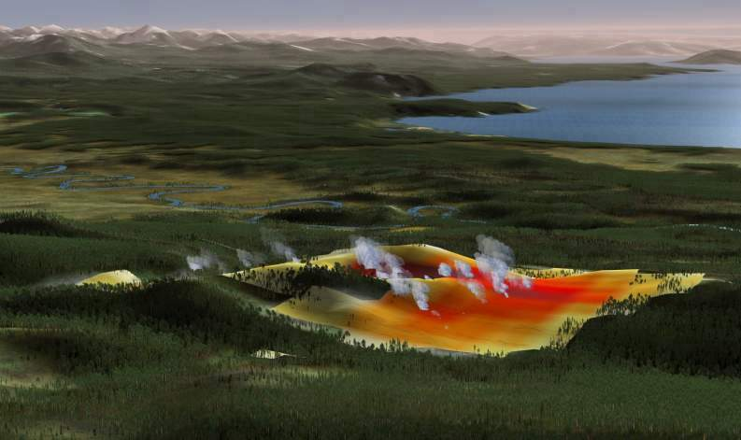
Bottom-up landscape science and visualization for wildlife management at Yellowstone NP and Carmel Bay (Systems Integration and Visualization of Yellowstone) Fred Watson^{1*}, Collaborators: Bob Garrott^{2*}, PJ White^{3*}, Susan Alexander^{1*}, Rick Wallen³, Wendi Newman¹, Thor Anderson¹, Tom Thein¹, Jon Detka¹, Alberto Guzman¹, Claire Gower², Jason Bruggeman²⁺, Matt Becker², Sally Plumb³, Chris Geremia³ James Lindholm^{1*}, Rick Starr⁴, Jessica Watson¹ ¹California State University Monterey Bay, ²Montana State University Bozeman, ³Yellowstone National Park, ⁴Moss Landing Marine Labs, *Principal Investigators, ⁺Formerly Presented at NASA Biodiversity and Ecological Forecasting Team Meeting May 7th 2009, New York, NY
Funding: NASA NCC2-1186 & NCC13-03009, NSF DEB 0074444 & DEB-0413570, NPS, NOAA (California Sea Grant)
EcoViz: Ecosystem Science and Visualization
Notes:
Abstract:
We have developed a variety of landscape modeling and visualization products for Yellowstone National Park in support of Visitor Interpretation, Research, and Park Management. One such product that we well demonstrate at this meeting is an Interactive Kiosk that is part of the new Canyon Visitor Education Center in Yellowstone. The kiosk takes visitors on a 'Virtual Interpretive Trail' through the Yellowstone landscape. Visitors chose to 'fly' from one place to another in a virtual reality setting; stopping at points of interest where they may choose to view relevant video stories. The idea is that the virtual trail recalls a metaphor with a conventional interpretive trail, although because it's virtual, it enables the visitor to traverse vast landscapes and whole seasons in just a few seconds. The product at Canyon Village centers on following the annual bison migration cycle, and the life history stories that accompany this journey. It is intended to add informed value to visitors' real experiences with bison in the Park. We argue that products of this kind have wide-reaching applications within Protected Areas throughout the world.

Slide 2
Broad, Robust, Efficient
But potentially more difficult to identify linkages between specific management environments and data products (?)
This project
More focused, decisions realized within project timeframe
But difficult to scale up & generalize
Therefore costly

Slide 3
Scale-dependency of interactions between ecology, administration, and outcomes
D
Agency
B
Management scale
A
C
Staff
Species
Decisions
Ecological scale
Outcome scale
Ecosystem
Policies

Slide 4
Scale-dependency of interactions between ecology, administration, and outcomes
D
Agency
B
Management scale
A
C
Staff
Species
Decisions
Ecological scale
Outcome scale
Ecosystem
Policies

Slide 5
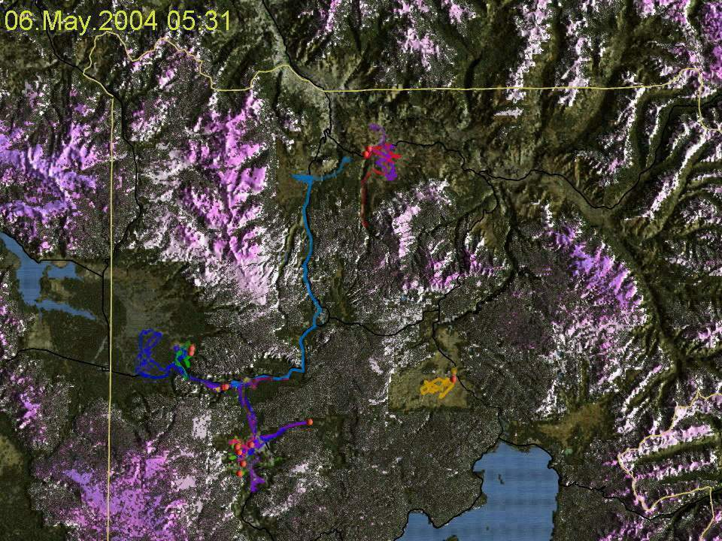
EcoViz: Yellowstone Ecosystem Science and Visualization

Slide 7
Journal
papers
Book
chapters

Slide 8
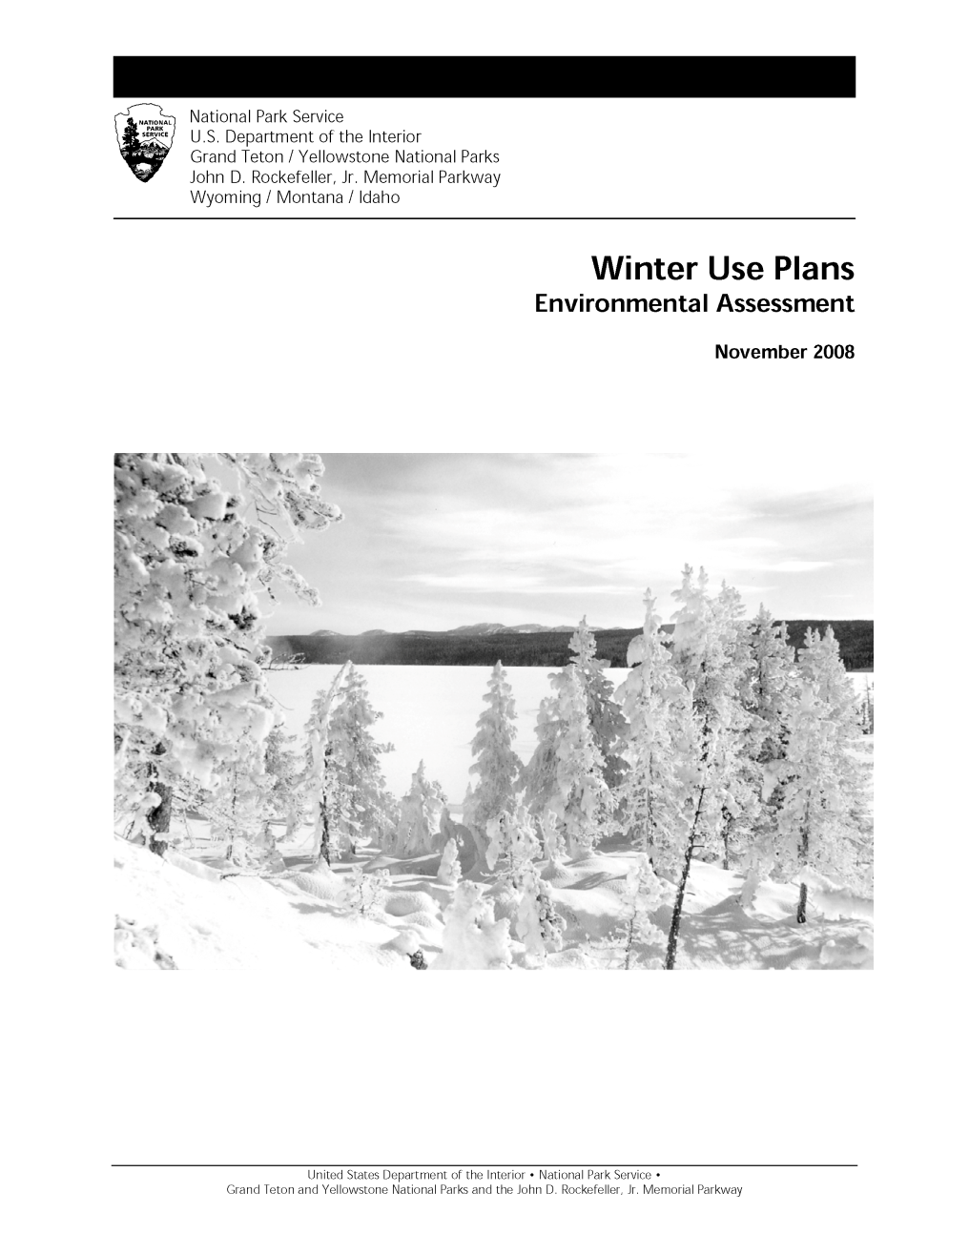
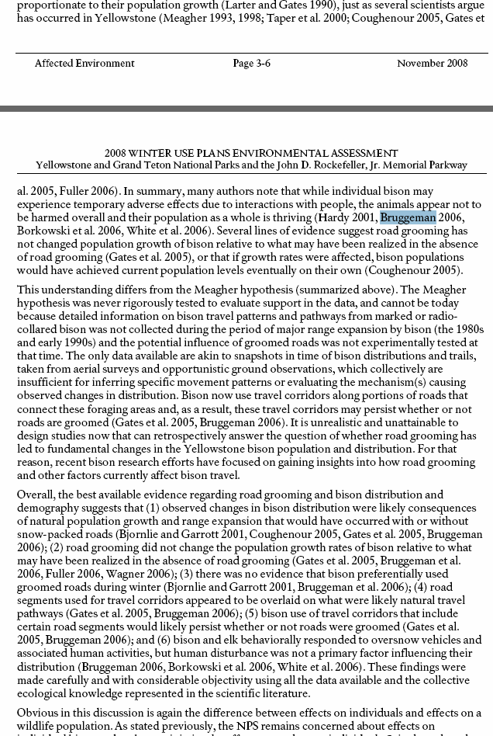

Slide 10
Journal
papers
Book
chapters

Slide 11
Rockfish movement and habitat in Carmel Bay, California

